Slide 1
Pan London Practice Learning Group
Practice Assessor Preparation Workshop
Notes:
Notes for the facilitator:
This course was revised in March 2025.
This workshop can be delivered in 1 day (minimum 5 hours). Please refer to the accompanying lesson plan. As facilitator, you may wish to include a workshop agenda slide at this point, with start time, session/topic timings, breaks etc. It is intended that this workshop can be subdivided into 3 sessions as outlined in the lesson plan:
Session 1 - Effective practice learning and supervision
Session 2 - Assessment
Session 3 - Confirmation of Proficiency
Depending on the learner cohort, type of delivery and time availability you may wish to include some of the other activities described in the Additional Workshop Activities document on the Educator Resources page.
There is some repetition in the workshop to enable learners to consolidate key messages and apply their learning. If any student has had challenges completing all online resources prior to the workshop they can still benefit from and learn from the slides, discussions and own experiences but must then complete the resources before being confirmed as prepared for the Practice Assessor role.
Whether the PA will be supporting students in a practice placement or as part of simulated practice learning the same principles apply.
These slides can also be used as part of preparation for the Academic Assessor role as the AA must fully understand the role of the PS and PA in supervising and assessing students.

Slide 2
Aim and Learning Outcomes
Aim: The learner will have an enhanced understanding of the role of the practice assessor and others in providing effective learning and assessment for their students.
Learning Outcomes:
At the end of this workshop it is expected that the learner will be able to:
apply their own learning from undertaking the identified pre work set out on the learner pages, prior to attending this workshop
demonstrate understanding of how the 3 key roles in SSSA work collaboratively to ensure the best possible learning experience for students on placement or in simulated practice
demonstrate understanding of the student’s assessment requirements and how the practice assessor, practice supervisor and academic assessor contribute to student assessment, feedback and performance management​.
​
Notes:
Teaching points
Hopefully, all participants will have completed the online resources as per the Development Route Map:
Completing the module ‘Fundamentals of the Practice Assessor Role’
Completing the modules 'Supporting Neurodivergent Students' and 'Assessing Neurodivergent Students' (resources published in September 2024)
Viewing the Revise and Refresh videos on the Initial, Mid-point and Final Interviews, Giving Effective Feedback and Action Planning.
Learners cannot be confirmed as prepared for the Practice Assessor role until all resources have been completed.
Learners should be encouraged to revisit these additional resources to refresh their knowledge and skills, especially when they have been allocated as practice assessor to a student and need to carry out these functions for the first time.
Check learner understanding of acronyms and terms, e.g. SSSA, Part.

Slide 3
NMC Standards for Education and Training NMC 2018, Updated 2023
Reflect the policies and processes that underpin the student journey from recruitment to registration
The Standards for Student Supervision and Assessment (SSSA) include the following (as introduced in the e-learning) are
Effective Practice Learning
Supervision of Students
Assessment of Students and Confirmation of Proficiency
Programmes include pre-registration nursing and midwifery, nursing associate and post registration programmes, for example non-medical prescribing and specialist community public health nurses (SCPHN)
Notes:
Teaching points
This is a reminder of the standards and to emphasise that the SSSA document provides more than just the information on the roles. Learners should be familiar with the components from undertaking the e-learning modules.
The NMC website provides multiple sources of information / guidance on the implementation of the standards.
The Standards for Education and Training also comprise the overall programme standards outlining processes of recruitment, DBS, numeracy, literacy, the wider learning culture, role of service users/ carers – all of which require joint working between universities and practice partners to implement. The standards also include the proficiencies and related skills that apply to each individual programme and most of which are reflected in the student assessment documents.

Slide 4
Activity 1: Roles and Responsibilities
Check your knowledge:
1. Who can be a practice supervisor?
2. Who can be a practice assessor?
3. What is the main role of the practice supervisor
4. What is the main role of the practice assessor?
5. What is the role of the academic assessor?
6. What is meant by supernumerary status on placement?
Notes:
Teaching points
Standards for Student Supervision and Assessment – SSSA . Need to emphasise the importance of Supervision in the title – this will also link with the No 6 re supernumerary status.
As per standards the PS can be any registered health and social care practitioner so a discussion regarding individuals within specific placement areas or simulated practice is important. This links with the discussion regarding Scope of Practice and the importance of having a registered nurse or nursing associate being the PS that contributes to the assessment of any nursing roles/duties. Need to emphasise that the PS cannot act as PA for the same student
The identification of the PA is more straightforward as it must be a registered nurse or midwife as appropriate and is responsible for conducting the summative assessment of practice.
Supervision, Support for learning and contribution to assessment as per no. 1. Need to recap on how the PS works collaboratively with the PA and AA (as needed), provides evidence re performance and documents appropriately
4. Summary of role on next slide as a reminder
5 How the AA is allocated may vary between Approved Education Institutions (AEIs) but the role itself remains the same as outlined earlier and in the SSSA.
6. The learner needs to have a clear understanding of what ‘supernumerary means….i.e. that students cannot be counted in the numbers….they cannot replace an absent HCA but can work under both direct and indirect supervision

Slide 5
Practice Assessor Role
Practice Assessor
Provides appropriate learning opportunities
Provides verbal and written feedback
Conducts evidence-based assessments
Maintains relevant knowledge and experience
Gathers feedback on performance from PS and others
Liaises with nominated AA
Raises and manages performance concerns
Notes:
Teaching points
The graphic shows the NMC requirements for the role.
The key to success in student learning and assessment lies with the PA understanding student needs and ensuring learning and assessment opportunities are provided.
Gathering feedback from other staff and encouraging staff, particularly the PS, to record their feedback in the assessment document is vital.
Conducting assessment in line with student assessment requirements is essential. Assessment related to nursing will be outlined further on to emphasise the importance of the PA completing specific assessments.

Slide 6
Student Responsibilities
Students must take a key role in their learning and assessment and must:
be prepared for and have a sound understanding of the assessment components they need to achieve and seek information on appropriate local learning opportunities
know the name of their practice assessor and academic assessor from the beginning of the placement
actively seek out practice supervisors to support their learning and complete reflections in their assessment documents
keep a track of the timings for their key interviews and assessments and approach their practice assessor (or other) to ensure they are scheduled appropriately
engage actively in receiving and providing feedback as required
raise concerns in a timely and appropriate manner
Notes:
Teaching points
There is an emphasis in the NMC standards on empowering students so the above points are important for the PA to share with students to encourage and support their engagement at all levels.

Slide 7
Activity 2: Identification of Student Learning Needs
It is essential that the practice assessor engages with student orientation even though they do not usually conduct this themselves. Areas to be explored as part of the orientation include potential reasonable adjustments and flexible working arrangements that may be required to support the student.
What type of reasonable adjustments might the student require and what is your experience of managing these to promote student well-being and progression?
In what way does your practice area support flexible working for students and what are the benefits?
Notes:
Teaching points
As part of the preparatory work the learners were asked to consider the types of reasonable adjustments they have observed being put in place or have supported in the past.
The implementation of student flexible working policies across London has been evident since 2021- started by Guy's and St Thomas' NHS Foundation Trust. With funding from NHSE London and the RePAIR progamme, a project was set up to implement flexible working policies for student nurses and midwives more widely.
Please refer participants to the student flexible working resources that are included on this website on the Further Resources page.
Also reference the modules on supporting and assessing neurodivergent students that learners should have completed prior to this workshop and engage them in the following activity/quiz (next slide) to check understanding.

Slide 8
Activity 3: Supporting Neurodivergent Students
Supporting Neurodivergent Students
Test your knowledge. True or False?
A range of neurological variations, including but not limited to Tourette’s syndrome, OCD, autism, dyscalculia, bipolar disorder and dyslexia, could be considered neurodivergent.
You should not assume that two neurodivergent students with the same diagnosis will need the same reasonable adjustments.
Allowing some students to have reasonable adjustments will cause inconsistency in assessments and be unfair to other students.
It is only necessary to discuss learning preferences with students that have a diagnosed neurodivergent condition.
Neurodivergent individuals usually have the same preferences, strengths, and needs.
Notes:
Teaching points
Staff should have completed the two e-learning modules 'Supporting Neurodivergent Students' and 'Assessing Neurodivergent Students'. If not, they must do so in order to complete their PA preparation.
This slide draws on questions from the final assessment of both modules.
Further 5 minute discussion: Ask learners to give examples of how adjustments can be made to support student learning and assessment when the student has a type of neurodivergence.

Slide 9
Activity 4: Coaching
Why is coaching important and how does it differ from mentoring?
Three frameworks were included in the e-learning module. These included the:
GROW: Goal, Reality, Options, Will
SOAR: Situation, Outcome, Action, Review/Reflect
Expansive Learning: Connecting, Establishing, Expanding
Identify one of these frameworks that best suits your own facilitating/coaching style.
Describe the role of the student to ensure coaching is effective.
Notes:
Teaching points
Definitions and further information on coaching is included in the e-learning modules.
GROW
Goal – identify the end goal or what it is the person is wanting to achieve. Reality – what is the current situation, what knowledge, skills and experience do they have. What have they tried so far? How successful has it been? Options – what could they do? What alternatives do they have?
Will / way forward – what are they going to do? How will they know when they’re successful?
SOAR: An alternative model, also with four stages, focuses on: considering the Situation initially before identifying the Outcome, looking at potential Actions and completing the cycle with Review and Reflect. Designed to complete the coaching cycle with the opportunity to review and reflect which fits well with nursing and encourages reflection and review of what has gone well.
Expansive Learning: Connecting - the interpersonal connection between the student and supervisor. Getting to know your student, identifying a joint learning plan (initial interview). Mutual engagement and commitment to learning begins. Establishing - continuing to build the two- way relationship, active listening, communicating, providing feedback, understanding the student’s learning style and building confidence. Expanding - supporting development of knowledge and skills through regular and constructive feedback. An interactive approach through encouraging questioning, problem solving, critical and self reflection as well as peer learning. (Morley et al 2021)

Slide 10
Activity 5: Types of Assessment
Learners were introduced to three types of assessment in the e-learning modules: Diagnostic, Formative and Summative.
Provide an example for each of the 3 types
What is the role of the practice assessor and practice supervisor with regard to conducting each type of assessment?
The practice assessor is encouraged to use different methods when conducting student assessment including direct observation and questioning.
Provide an example to demonstrate use of effective questioning and outline the importance of both direct and indirect observation
Identify two other methods that may be used
Notes:
Beginning of Session 2: Assessment Activity
Teaching points
Within the Revise and Refresh videos, learners were informed that:
the initial interview is an example of diagnostic assessment,
the mid-point is an example of formative and
the final is an example of summative.
There is also a formative episode of care in the Part 1 nursing and nursing associate PADs followed by a number of summative EoC assessments and medicines management assessments.
Slide 12 reminds learners about the assessment criteria in the nursing PADs.

Slide 11
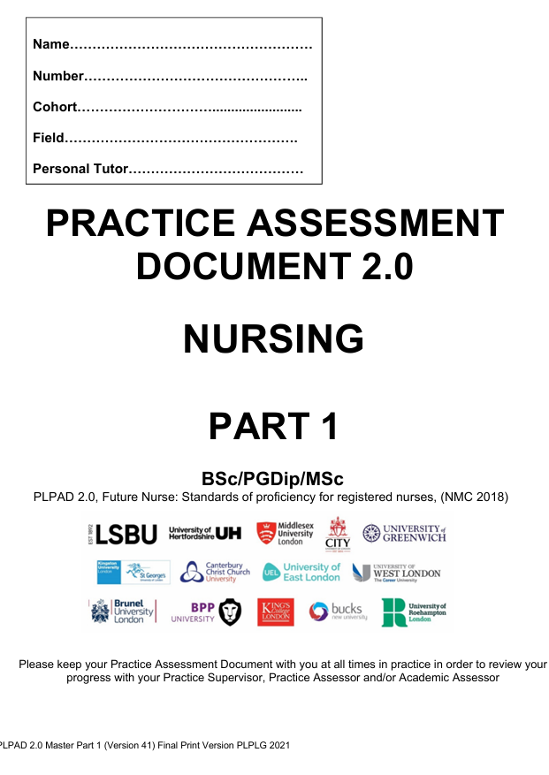
Activity 6: Components of Assessment
This depends on the programme of study. In pre-registration nursing there are three Parts to be completed across the programme for nursing students and two Parts for nursing associate students.
There are a number of assessment components in each Part.
Provide a brief description of each of the components
Outline the various ways in which students can gain documented feedback on their performance
Consider the criteria for assessing a pre-registration nursing student at each level and provide an example that demonstrates the level of knowledge and skills you expect to observe in Part 1, 2 and 3.
Notes:
Teaching points
Types of assessment include:
Professional Values
Proficiencies (including cross over proficiencies)
Episodes of Care
Medicines Management
Responsibilities for assessment / documentation on the next slide
Slide 14 focuses on the ePAD and the facilitator may use the ePAD guide/learning resource to emphasise and remind staff about the various components of the PAD (or eMORA as appropriate)
The criteria in the Nursing PAD/ePAD is as follows – this was included in the e learning module
By the end of Part 1: Guided participation in care and performing with increasing confidence and competence
By the end of Part 2: Active participation in care with minimal guidance and performing with increased confidence and competence
By the end of Part 3: Practicing independently with minimal supervision and leading and co-ordinating care with confidence

Slide 12
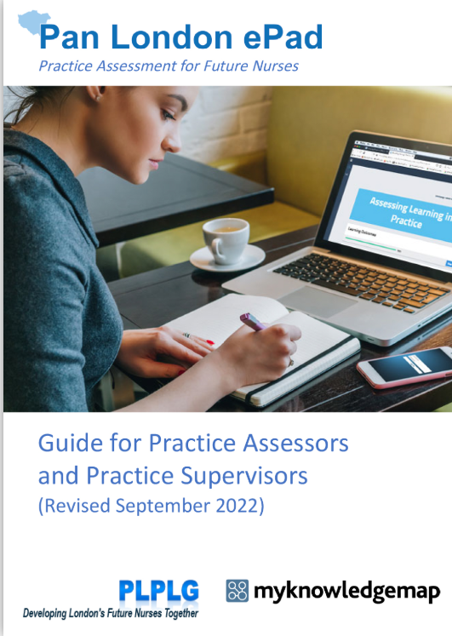
Activity 7: ePAD
The ePAD is an online assessment tool being used by many students across London. Within the e-learning module you will have been directed to useful online resources.
How confident do you feel in using the ePAD?
Identify 3 key messages to ensure effective assessment that you would share with a Practice Supervisor?
Identify 3 key messages you would share with students?
Notes:
The facilitator may wish to incorporate further information on the ePAD (or the one hour ePAD training session*) and draw attention to the resources on the website to support practice staff. The slides following this focus on the components of assessment that apply whether the ePAD is being used or not.
Note that some universities use alternative assessment tools, but any tool should provide the same support for supervision and assessment functions as the original paper PAD.
This slide can be altered to 'eMORA' if the learners are midwives; or add eMORA references if the audience is mixed.
*There is a separate ePAD workshop pack available. Contact your partner university if you don’t already have this.

Slide 13
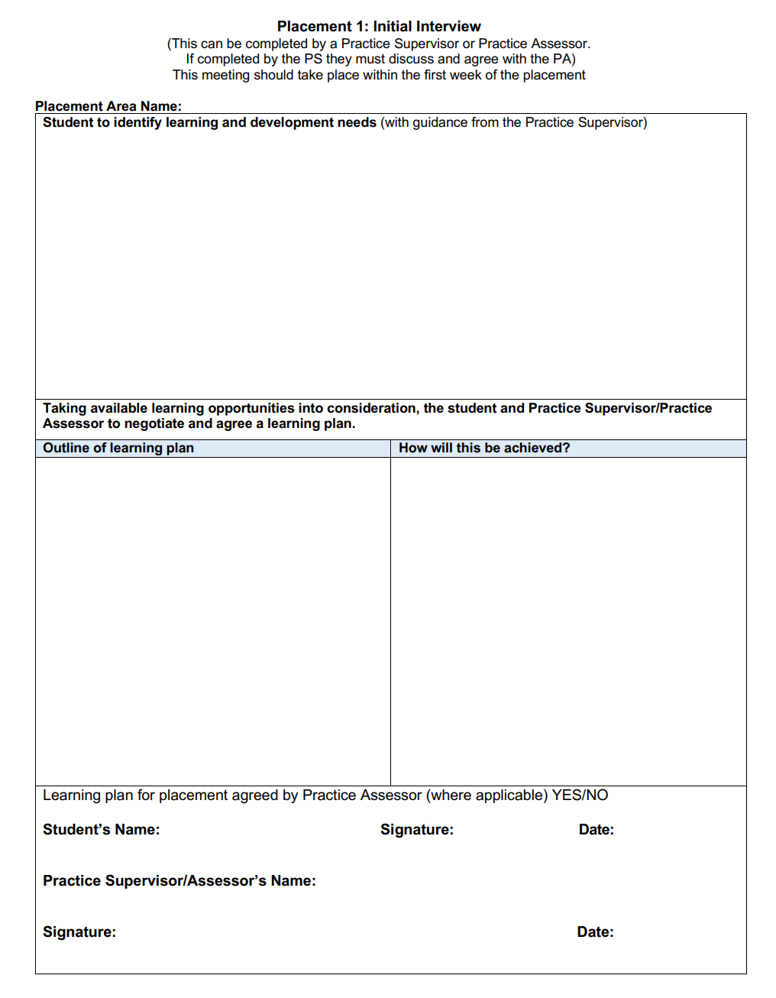
Activity 8: Initial Interview
To care for deteriorating patients
Undertake risk assessments
Complete my medicines management
Improve my communication and interpersonal skills
Complete my medicines management
Who is responsible for undertaking the initial interview?
Grace, a year 2 student is undertaking her final placement of Part 2. The PS has completed the initial interview and has asked you to review it. It reads as per the example:
What is your assessment of the learning plan?
What advice would you provide the practice supervisor and student with regarding the content of this interview in order to ensure the learning plan is more focused and relevant?
For Grace to care for patients who are deteriorating,
To undertake risk assessments,
To complete her medicines management
To develop her verbal and non-verbal communication skills
Grace will be allocated a group of patients.
Will be asked to reflect on experiences
Seek feedback from others
Provided with relevant opportunities
Notes:
This slide includes the original form, taken from nursing PLPAD2.0. Most nursing students will be using an online tool such as the Pan London ePAD, but this varies depending on university. Any online tool will have the means to capture the same information as the original form.
Teaching points
The initial interview may be the first time that the practice supervisor or practice assessor has dedicated one-to-one time with the student.
If the initial interview is conducted by the practice supervisor then the practice assessor must be made aware of the learning plan and any specific student needs.
Activity notes
This learning plan is very vague and does not provide clear direction for the student. Whilst the plan does not require specific objectives it is still useful to consider the principles of SMART objectives to make this more meaningful.
The PS should be aware of which proficiencies are outstanding in the assessment document. Has the Episode of Care been completed?
The student could be supported by focusing on 2 or 3 areas at the beginning for review at the mid-point interview.
The learners should be reminded of the Initial Interview Revise and Refresh video on the Learner Resources page for more detailed guidance.

Slide 14
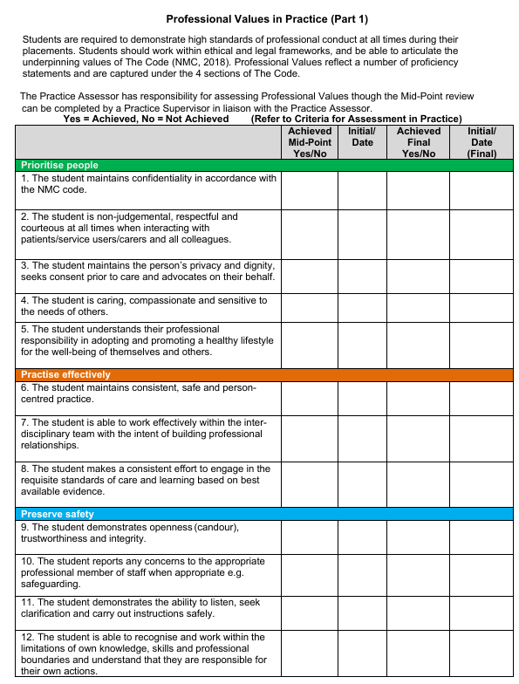
Professional Values
As the practice assessor you must ensure you are familiar with the professional values
If available, review and discuss the previous reflection documented by the student to help them enhance their understanding of the Code.
Consider further examples the student could record in order to reflect on care delivery in your area to ensure an authentic assessment
Notes:
The facilitator may present this as a reminder as hopefully all participants will have been supporting students in a PS role and are already familiar with the Professional Values requirement – again depends on the audience.
Teaching points
The important point for the PA is to ensure there is consistency in achievement of the values and that the student account is authentic and clearly reflective of their practice in that specific area.
The student account must be discussed with them to ensure it is authentic.

Slide 15
Nursing PLPAD 2.0: Responsibilities for Assessment and Documentation
Practice Supervisor
Completes:
Initial Interview
Mid-point Professional Values
Formative Episode of Care (Part 1)
Service User Feedback
Additional Professional Feedback
AND
Contributes to Assessment of Proficiencies (based on Scope of Practice)
Practice Assessor
Contributes to Initial Interview (though may complete this in some areas)
Reviews the assessed Mid-point Professional Values (though may complete this in some areas)
Completes:
Mid-point and Final Interviews
Final Professional Values
Episode(s) of Care
Medicines Management
OAR at end of each placement and at programme progression
Notes:
Teaching points
An important reminder for PS and PA responsibilities.
Where responsibility can be with either the PS or PA (e.g. Initial Interview and Mid-Point Professional Values) discuss the policy in your area(s).

Slide 16
Activity 9: Assessment of Proficiencies
Jacob, a first-year nursing student completing his final placement of Part 1, has the following two proficiencies outstanding:
5. Demonstrates an understanding of the importance of therapeutic relationships in providing an appropriate level of care to support people with mental health, behavioural, cognitive and learning challenges.
24. Accurately undertakes person-centred risk assessments proactively using a range of evidence-based assessment and improvement tools.
Considering your own area of practice, what opportunities would you provide Jacob with to achieve these proficiencies?
What knowledge and skills would you expect Jacob to demonstrate to ensure he has met these proficiencies?
Notes:
Teaching points
The two proficiencies in this activity are included in the Part 1 nursing and nursing associate practice assessment document.
The student may be on a placement reflecting any of the 4 fields of practice and hence the PA needs to consider how opportunities for assessment can be provided and how achievement is evaluated.
It is likely to include a combination of observation, reflection and Q&A and needs to be assessed in the context of the field of practice.
It is essential that the student understands what is expected of them.

Slide 17
Activity 10: Assessment Concerns
Scenario One
Student A is on a four-week placement in year 2. On week 2 the PS has raised some concerns with you as the PA regarding her knowledge and skills related to common medications administered in the area as well as drug calculations.
Scenario Two
Student B is on an eight-week placement at the beginning of year 3 in the CAMHS Eating Disorder Unit. In week 3 the PS has raised concerns about his time management as he has been late for work on three occasions. Despite feedback there has been no improvement.
As the Practice Assessor you have arranged to meet with the student:
What communication and interpersonal skills do you need to demonstrate?
What do you need to address in the meeting?
What would you do after the meeting?
Notes:
Teaching points
Some key points that apply to both scenarios are included below as a guide.
The PA needs to have a clear understanding of the concerns raised by the PS – with supporting evidence prior to meeting and to arrange to meet with the student asap
Asking the student to explain why they feel concerns were raised and what they might have done about the concerns to address them.
Important to link the concerns with specific professional values and / or proficiencies
Provide advice / guidance, evaluate student understanding re what they need to do
Consider liaison with AA and possibility of action plan to support
Clearly document discussion and any related action and feedback to PS/AA etc

Slide 18
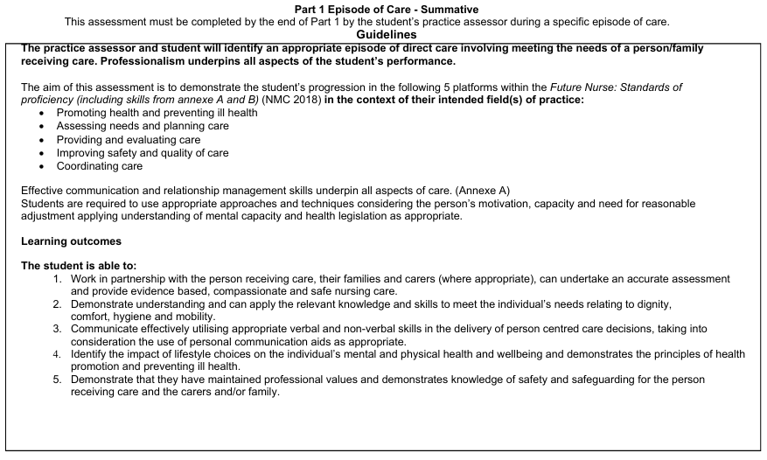
Activity 11: Episode of Care
What is the purpose of the Episode of Care?
How many Episodes of Care does a student need to complete in each Part?
How can a Practice Supervisor support the assessment of an Episode of Care?
What are the key principles to ensure the Episode of Care is effectively assessed and appropriately recorded?
Notes:
Teaching points
Remind learners about the number of Episodes of Care assessments that need to be completed. This information was detailed in the e-learning module Fundamentals of the PA Role as well as the PS role e-learning.
Examples of completed episodes of care will be made available on the Further Resources page, in the Assessment Support section.

Slide 19
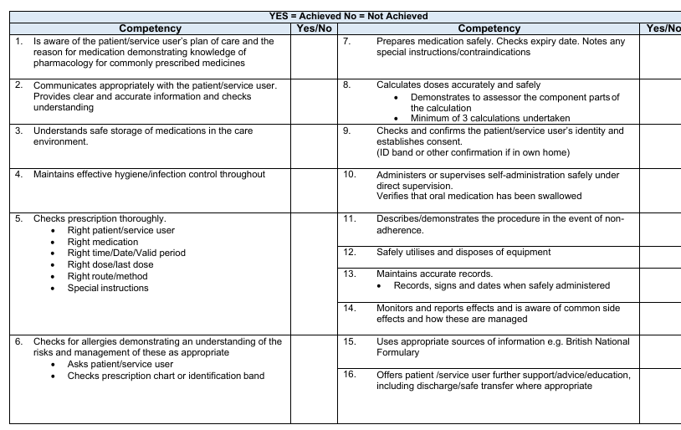
Activity 12: Medicines Management
Nursing student Michael is preparing for a drug calculation assessment as part of his Medicines Management evaluation. He has dyscalculia, which means he may experience difficulties with mathematical concepts.
How can a practice assessor create a supportive and inclusive environment for Michael to ensure a fair evaluation of their proficiency?
(Taken from: Assessing Neurodivergent Students e-learning module)
Notes:
Teaching point
The learner should be able to recall their learning from the ‘Assessing Neurodivergent Students’ e-learning module.

Slide 20
Documenting Feedback
There are a number of areas within the student practice assessment document (or online assessment tool) aimed at collecting crucial feedback for the student.
These include:
Mid-point interview
Final interview
Patient/Service User/Carer feedback
Peer feedback
Additional professional feedback
Reflection on learning from others
Notes:
Teaching points
Make reference to the PAD / ePAD where individual forms are used to collect the various sources of feedback.
The Revise and Refresh videos on the interviews will help with understanding of the importance and skill of documenting feedback.
Ensure the learners are aware of the range of feedback that can support them in their decision making.

Slide 21
Types of Feedback
Definition: Information relating to performance or behaviour in a specified activity or situation given with the aim to help the other person to develop.
Falls into three categories:
Positive - praise to motivate and value
Constructive - feedback to develop
Negative - destructive and unnecessary
Notes:
Teaching point
The facilitator could discuss some examples of the three types of feedback with the learners.

Slide 22
Giving Effective Feedback
DO
Give timely feedback
Give specific examples
Be constructive and positive
Explore a way forward
Check student understanding
Record your feedback in the student assessment document
DON’T
Use the word 'but'
Use negative language
Criticise - be constructive
Generalise -be specific
Try to change personalities
Notes:
**Adapted from UoB Written Feedback Cheat Sheet (2022), Mark Waring, University of Bedfordshire**
Teaching points
• Focus on the ‘who, what, where, when and how’
Reflect on the performance of the learner using examples of what you have actually observed.
• Avoid being evaluative
If a learner is told there is practice is simply ‘good’ they may infer that no further development is necessary. The word ‘bad’ might be interpreted as final or incontestable. Phrases that explore the effectiveness, strength or weakness of aspects of a learner’s practice are more effective.
• Identify ‘to what end’ the feedback is to be given and whether the feedback needs to be shared
Determine which parts need to be written, which parts need to be verbal and identify the best location and place for the learner to feel safest and at the optimum time for the feedback to be ‘taken up’.
• Take into account whether the feedback should be given during performance or post-performance
Decide whether the feedback should be given as a ‘flow’ of information or be discursive where the student describes the episode of care and evaluates their own performance.
• Use suitable vocabulary that is inclusive (encouraging) rather than final (incontestable) and that allows responses and questioning from the learner. Be aware of non-verbal dynamics such as your body language.
• Include a balance of comments confirming good performance whilst emphasising improvement of performance in relation to standards of good work.
Provide examples by commenting on aspects of their work and behaviour.
• Provide the learner with strategies that are ‘forward-facing’ and ‘future referenced’ e.g. “When we work together next week we will…”; “in preparation for next week try…”
• End with a summary that enables the supervisor/assessor/educator to check shared understanding
Ask the learner to summarise the feedback given or identify the ‘take-home’ messages.

Slide 23
Activity 13: Underperformance
How do you recognise underperformance in a student?
What are some of the causes of underperformance?
Notes:
Teaching points
This could be the start of Session 3 that focuses on the final section of the SSSA: Confirmation of Proficiency as it addresses areas related to underperformance, action planning and managing both the struggling/failing student as well as the higher performing student.
Following slides provide key points to support student feedback on this activity.

Slide 24
Recognising Underperformance
Student
Changes in attitudes and behaviours
Poor time management
Lack of initiative
Lack of self-awareness
Poor performance
Lack of knowledge
Poor communication
Notes:
Teaching point
These are just examples. The learners may identify a number of other ways in which they have been able to recognize underperformance

Slide 25
Causes of Underperformance
Unclear expectations
Insufficient support, including poor understanding of reasonable adjustments / neurodivergent condition(s) by the PS/PA
Working relationships or culture of setting
Lack of interest in setting / working environment
Insufficient knowledge or skills
Feelings of inadequacy and/or personal problems
Poor communication
Insufficient feedback
Notes:
Teaching points
Again it is expected that learners would be able to identify the main causes as listed above and the slide is used to emphasise these or draw on individual experience – time depending.
It is important to emphasise that it is not solely the student that may be ‘at fault’ and that the relationship between student and their assessor/supervisor is vital in supporting learning and avoiding ‘underperformance’ wherever possible.

Slide 26
Addressing Problems
As early as possible
Giving feedback directly to student in private area
Provide specific examples
Consider areas for improvement
Identify actions and timeframes
Gain commitment from the student
Coach and support student
Notes:
Teaching point
This is a reminder of key priorities, again emphasisng the importance of the relationship, support and supervision.

Slide 27
Action Planning
An action plan must be completed by the practice assessor if there is cause for concern in relation to the student’s performance
The practice assessor must liaise with the academic assessor
The action plan meeting must include the student, the PA and, ideally, the AA, and the practice supervisor who will be supporting the student to achieve the objectives set
The action plan must be captured in the student assessment document (or online tool)
The practice assessor is responsible for reviewing progress and ensuring support and learning is provided to the student
After the agreed time has elapsed the practice assessor must assess progress and complete the relevant review form.
Notes:
Teaching Points
The learner should have some insight into action planning. The Revise and Refresh video on action planning is part of the preparation for the PA role.
This should therefore be revision but nevertheless important repetition to ensure understanding.
The facilitator may contribute further understanding of policy in their area, e.g. when and how the practice education team should be involved.

Slide 28
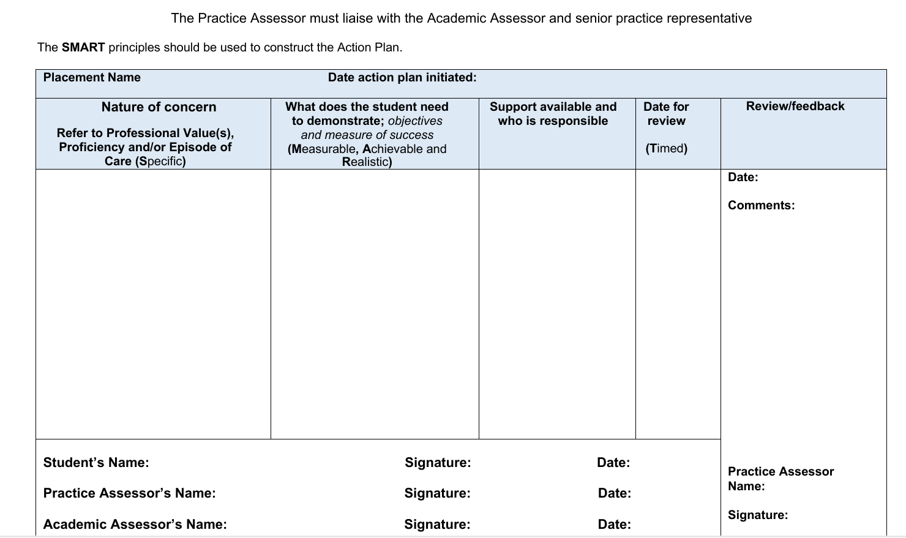
Action Plan Template
Notes:
A reminder of the AP template to support the next activity. Note that this is the PAD layout. Format will be different in an online tool, but the key elements will be the same.

Slide 29
Activity 14: Action Plan
Review the case study related to student nurse Lianne and develop an action plan to support her development and achievement of the identified proficiencies.
Notes:
Case study to reflect assessment decisions and the role of the PA, PS and AA in student supervision and assessment (also embedded as a word document link in the Lesson Plan)
Lianne is a Year 2 student is in the 4th week of an 8 week placement in a 24 hour service. The student’s Practice Supervisor has raised some concerns regarding her competence with some proficiencies following several opportunities working with Lianne. The competencies are:
Proficiency No 7. Maintains accurate, clear and legible documentation of all aspects of care delivery using digital technologies where required.
Proficiency No 23. Undertakes assessments using appropriate diagnostic equipment in particular blood glucose monitors and can interpret findings.
The Practice Supervisor is a nurse who has been qualified for 18 months and has supervised other students. The PS has worked 4 shifts with Lianne. The PS has assessed these proficiencies and documented that the Lianne has “not achieved” proficiencies 7 and 23 due to inaccurate recording of blood glucose levels and failing to interpret and report the findings to an appropriate member of staff.
The Practice Supervisor reports this to the Practice Assessor who arranges to meet with Lianne for the mid-point interview.
What communication and interpersonal skills would the PA need to demonstrate when meeting with Lianne?
Where would you meet with the student to ensure privacy?
Would you meet the student in a 1-2-1 meeting?
How would you respond to the student if they become angry or distressed?
What verbal and non-verbal communication skills would you use?
What do you need to address in the meeting?
How would you facilitate the student to reflect on their practice and competence in relation to the not achieving proficiencies 7 and 23?
How would you explore the implications of this with the student.
How would you formulate an action plan with the student?
How would you provide the student with further learning opportunities?
What would you do after the meeting?
Who would the PA need to inform?
What would the PA document and where?
How would the PA ensure the student was supervised and monitored?

Slide 30
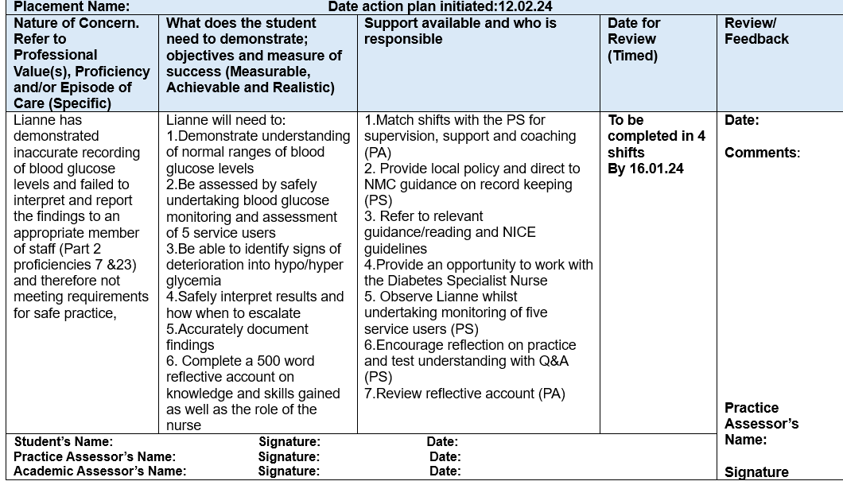
Example of Completed Action Plan
Notes:
Teaching point
This provides an example of a completed form to share with the students. This is included in the ‘Assessment Support’ section of the Further Resources page, so that the PA can review it if and when they need to develop an action plan in practice.

Slide 31
Failing a Student
Joint responsibility of practice assessor and academic assessor
Opportunities to achieve must have been provided
Robust evidence and supporting information and documentation from other staff / practice supervisors must be considered
Ensure the student has been provided with specific examples that relate to their assessment requirements
A full review of any action plan(s) must have been undertaken WITH the student
Prepare for student's reactions and impact on team
Consider own feelings and how to access support
Notes:
Teaching points
Whist every effort is made to support student achievement, there are occasions when a student does not demonstrate the required knowledge, skills and attitudes to meet all assessment requirements.
By not meeting proficiencies, professional values or other assessment components at the end of the placement then this may be deemed a ‘fail’.
Depending on the Approved Education Institute policy or nature of the placement the student may have a reassessment opportunity.
A ‘fail’ on placement does not mean the PA is responsible for the discontinuation of the student on the programme. They are responsible for the assessment of that particular placement and so must ensure effective liaison with the AA who will be familiar with overall student performance and programme requirements.

Slide 32
Activity 15: Managing a High Achieving Student
Towards the end of a Part/Year some students appear to have very few proficiencies left to achieve in their practice assessment documents with all other components of assessment completed.
In discussion regarding their previous experiences and learning they appear to be confident and competent and have received very positive feedback.
Discuss how you would continue to engage this student to further enhance their learning and development?
Notes:
Teaching points
It is important to not just focus on students who have outstanding components in their assessment documents as all students should be motivated and encouraged to learn and develop beyond what is required to achieve a pass.
It is also essential to be mindful of the fact that a student’s previous assessment may not have been robust and a student’s performance must be consistent and not reflect a one-off observation.
Applying their learning to a new area / situation can sometimes challenge students.
For those students whom you feel are genuinely high-achievers then look at other ways to motivate and challenge them through provision of additional learning opportunities promoting further leadership, teaching and management skills.

Slide 33
References
Lobo, C., Paul, R., Crozier, K. (2021) Collaborative Learning in Practice: Coaching to Support Student Learners in Healthcare, Wiley-Blackwell
Morley, D.A. Wilson, K. and Holbery, N. (2019) Facilitating Learning in Practice; A research-based approach to challenges and solutions, Oxon, Routledge.
Nursing and Midwifery Council (2019) Raising concerns: Guidance for nurses, midwives and nursing associate, London, Nursing and Midwifery Council
Nursing and Midwifery Council (2023) Standards of Education and Training. Standards - The Nursing and Midwifery Council, London, Nursing and Midwifery Council
Royal College of Nursing (2019) Practice Supervision Using a Coaching Approach. https://youtu.be/_RcUZy7e4_A London, Royal College of Nursing

Slide 34
What Next?
Revisit and make full use of resources on the NMC, PLPLG and STEP websites
Familiarise yourself with the student assessment document and guides (PAD / online assessment tool, eMORA, SCPHN) and revisit the ‘Revise and Refresh’ videos
Support for you as a new practice assessor (1st student) – ask to be allocated a buddy who has experience as a practice assessor and can provide additional guidance/advice at key points during your first student placement (this should coincide with the key interviews/assessments).
Attend PS/PA update sessions when available and read update communications
Consider how undertaking this role will support your NMC revalidation (this workshop can comprise one of your reflective accounts for submission)
A certificate of achievement will be sent to you following this workshop (5 Hours = 5CPD points.
Notes:
Notes: Facilitator to summarise, check if there are any final queries/questions and confirm that a certificate to reflect the learner’s preparation as a practice assessor will be emailed to attendees. A template for the certificate will be made available to facilitators.

