Slide 1
Pan London Practice Learning Group
Practice Supervisor Preparation Workshop
Notes:
This course was revised in February 2025.
This workshop can be delivered in 0.5 day (minimum 2 hours). Please refer to the accompanying lesson plan.
Depending on the learner cohort, type of delivery and time availability you may wish to include some of the other activities described in the Additional Workshop Activities document.
You can decide how much time to spend on individual slides. The lesson plan provides a framework and can be used flexibly.
At the end of workshop, staff should be signposted to further resources to enhance their knowledge and understanding.

Slide 2
Aim and Learning Outcomes
Aim: To consolidate and enhance knowledge and skills related to the role of the practice supervisor in supporting learning and assessment in practice
Learning Outcomes:
At the end of this workshop it is expected that the learner will be able to:
discuss the role of the practice supervisor on placement and/or simulated practice in the context of the NMC standards
identify individual student’s learning needs and demonstrate understanding of how to support neurodivergent students
demonstrate understanding of the student’s assessment requirements and the role of the practice supervisor in coaching and contributing to assessment, feedback and performance management
Notes:
Teaching points
Staff are directed to undertake the following prior to attending this workshop:
The e-learning module ‘Fundamentals of the PS Role’ provides an introduction to the role as well as providing some insights to the PA and AA roles.
The Revise and Refresh videos on the Initial Interview and Giving Effective Feedback, for more in-depth understanding of these key skills
This workshop provides the opportunity to enhance understanding through exploration of topics in greater depth. Some repetition is deliberate, to ensure all learners reach the same level of understanding.
Check understanding of acronyms and terms, e.g. 'Part' - a stage/level of the programme, AEI – Approved Education Institution.

Slide 3
NMC Standards for Education and Training NMC 2018, Updated 2023
Comprises 3 Parts – as presented in the introductory module
Part 1: information on the overall standards for nursing and midwifery programmes Part 2: standards for student supervision and assessment (SSSA)
Part 3: processes and policies underpinning student recruitment to registration for individual programmes
In addition, there is a document outlining the proficiencies for each programme
The key roles for supporting supervision and assessment in practice are:
• Practice Supervisor (PS) • Practice Assessor (PA) • Academic Assessor (AA)
Useful video and other material: SSSA Supporting Information hub - The Nursing and Midwifery Council
Notes:
Teaching points
Learners were introduced to the various components of the NMC Education and Training Standards in the introductory module and it is important for the facilitator to differentiate between these parts and the Nursing/Nursing associate/midwifery assessment documents where Parts reflect the stages of the programme.
The NMC video on Supervision and the SSSA is in the online preparation module. Whilst the video focuses on what students should do it is a very good summary of the roles. (If learners have not already accessed the video as part of the online preparation module, they should be encouraged to do so after the workshop.)

Slide 4
Activity 1: Learning in Practice
Identify the range of healthcare professionals who can support students in practice and explain how they may contribute to assessment ?
Notes:
Teaching points
Within the introductory module the learner was asked to consider the range of students in their placement area as well as the opportunities. This activity builds further on this.
It is important to emphasise the range of staff that can support learning and, at times, assessment. Scope of practice will be considered later.
Since the learners present at the workshop are likely to come from a range of placement areas across professions and fields of practice they will no doubt share many different examples.

Slide 5
Supporting Learners in Practice
The PS may supervise multiple students at the same time
Each student may have several PSs
Each student will have an allocated PA where a summative assessment is being undertaken
The PS cannot also act as the PA for the same student
Any registered healthcare staff member can be a PS
Each student must have a named AA
Notes:
Teaching points
This information is taken from the SSSA document. Again, learners will have been introduced to this in the introductory module.
Some of the detail and explanations related to this slide will be drawn out in the next activity.

Slide 6
Activity 2: Reflection on e-Learning (Fundamentals of the Practice Supervisor Role module)
Working in small groups:
Why is being a positive role model so important?
As a PS what do you identify as your first two priorities when you meet a student for the first time?
Why does the PS need to work within their scope of practice…..and what does this mean?
Identify 3 further aspects of the PS role
Notes:
Teaching points
Within the online preparation work the learner was asked to consider what being a positive role model is, how it links to their Code and why it is significant when being a supervisor. Do emphasise the Code (for nursing/midwifery audiences) and how supporting learning is everyone’s responsibility.
Regarding priorities as a PS - the learner may mention the need to welcome the student, ensure they know who their PA is, have a planned orientation and a date / time for the initial interview (only examples)
Exploring scope of practice is very important. Within the preparation module the learner was asked to consider their understanding of ‘scope of practice’. They were also directed to the NMC page that discusses knowledge and skills of the PS.
Allow 15 minutes for this reflective work in small groups, including feedback.

Slide 7
Practice Supervisor’s Role
Practice Supervisor
Provides learning opportunities
Provides verbal and written feedback
Contributes to assessment
Has relevant Knowledge and experience
Understands assessment requirements
Shares observations with PA/AA
Raises concerns re performance
Notes:
Teaching points
The graphic shows the NMC requirements for the role. This slide was also included in the introductory module but is a useful reminder.
In addition, we will look at what skills you need to be effective in the role, for example, relationship building, empathy, kindness, curiosity, concern, care, inclusion, positive role model.

Slide 8
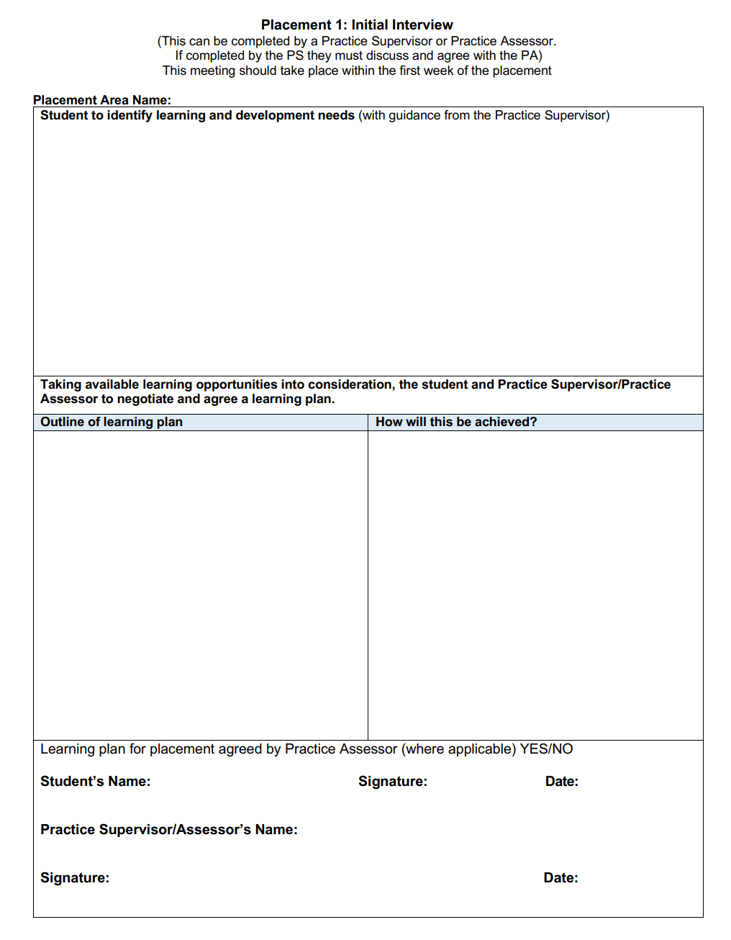
Activity 3: Initial Interview
After listening to the ‘Revise and Refresh’ resource on the initial interview outline 3 key points to ensure a realistic plan can be developed to support student learning.
Outline examples of possible reasonable adjustments that a student may require
How might a SLOT analysis (next slide) help in identifying student learning needs as well as opportunities to meet those needs and/or any threats that may pose a challenge?
Notes:
NOTE: This slide shows the paper form, as used in nursing / NA PADs. Most students will be using an online tool such as the Pan London ePAD, but this varies depending on university. Any online tool will have the means to capture the same information as the original form.
If this workshop is being facilitated by a university then you have the option to change the form in the slide so that it represents the university’s assessment tool.
Teaching points
Much of this information is included in the Revise and Refresh video on Initial Interview that the learner should have viewed prior to attending the workshop:
The initial interview is often the first time that the practice supervisor has dedicated one-to-one time with the student.
Before the interview, be in contact with the practice assessor and get any specific input to the learning plan. Also agree a mid-point interview date and time if possible (see below).
When organising the interview, ask the student to bring their PAD, or ask for access to their online assessment tool.
Give yourself time to read key documentation from earlier placements (especially the final interview and any action plan completed).
Utilise the interview to build a relationship with the student, ask the student about their progress to date, understand where they are in their programme / Part, what they need to achieve, how they learn best, discussing reasonable adjustments including any neurodivergent conditions.
Build the learning plan with the student.
Identify how the student will learn and who will support them (including colleagues and outreach opportunities)
Set a date and time for the mid-point interview if it’s possible to do so. Note that the mid-point interview is conducted by the Practice Assessor. This gives the student a clear timeframe (e.g. to experience w, y, z before the mid-point interview). It also removes stress for the student trying to get an interview organised closer to the time, when diaries might already be busy.
See slide 9 as a reminder of a SLOT analysis.

Slide 9
SLOT Analysis
Strengths Student’s current knowledge Student’s current skill levels Previous experience Professional attitude | Learning Needs Gaps in knowledge Proficiencies to be met Lack of experience Insufficient skill practice
Opportunities Development in practice, e.g. training, shadowing, meetings, observation Self-directed learning, e.g. research, reading Outreach placements | Threats Staff time and workload Lack of opportunity Lack of support Lack of understanding of student’s circumstances, including reasonable adjustments / neurodivergence
Notes:
NB If time /location allows, the facilitator may wish to introduce Role Play – working in pairs, one learner can be the PS and one the student. The student is presenting as a year 2, placement 1 BSc nursing student. The student is allocated to a community-based placement for the first time. The student and PS can reflect any of the fields of practice or the NA programme – depending on their experience.
Teaching points
The SLOT analysis must be in the context of the student’s stage in their learning, the practice setting and the length of placement.
The practice supervisor should aim to maximise the opportunities available to the student and minimise the threats to learning.
The practice supervisor must discuss with the student any threats (barriers to learning) that come from the student’s circumstances, including reasonable adjustments and neurodivergent conditions.
Any threats that are outside the ability of the practice supervisor to manage must be escalated to the appropriate senior staff, e.g. if the PS knows that they will be away for a significant period of the placement.

Slide 10
Supporting Neurodivergent Students
Supporting Neurodivergent Students
Discussed as part of the orientation and initial interview:
Potentially 15% of the population have one or more forms of neurodivergence – includes autism, ADHD, dyslexia, dyscalculia, dyspraxia, Tourette’s syndrome
Students may not have a diagnosis but may still need extra support
Supervisor must ask students about personal circumstances including reasonable adjustments in the initial interview
Supervisor must share reasonable adjustments with colleagues (unless the student specifically declines this) and facilitate the necessary adjustments
Understanding and supporting neurodivergent students will increase their chance of success on their programme
Notes:
Teaching points
Learners will have identified a number of situations that students present with requiring reasonable adjustments. These may be related to changes in personal circumstances or health related. This will have included the needs of neurodivergent students.
They should have completed the e-learning module on Supporting Neurodivergent Students on the Learner Resources page on the website. If not, remind them to do so. The e-learning was developed by neurodivergent students and staff. This slide pulls out some key points but the learners must complete the e-learning module for a full appreciation as part of their PS preparation.
5 minute activity: Ask staff to give examples of how adjustments can be made to support student learning and assessment when the student has a type of neurodivergence, e.g. autism, ADHD, dyslexia, dyscalculia, dyspraxia, Tourette’s, other.

Slide 11
Turning Learning Needs into the Learning Plan
In the initial interview you will agree a learning plan with the student. It is useful to consider the following:
Prioritise learning needs given the placement opportunities (what)
Consider the student’s preferred learning style and circumstances
Identify appropriate learning activities (how and who)
Determine the timeframe (when)
Agree how to measure achievement
Consider SMART objectives to support students where needed (next slide)
Notes:
Teaching points
Preferred learning styles is covered in the online preparation module and developing a learning plan within the Revise and Refresh initial interview’ video.
Consider prioritising learning needs depending on the individual, their experience, the setting, the assessment requirements.
Only set two or three objectives for personal development for each period.
Encourage the student to identify preferred ways of learning and to come up with ideas so that they take responsibility for their own learning.
Emphasise that there are different ways of learning including shadowing, on the job, e-learning, reflection, independent study (depends on setting).
Consider outreach placements (can be from as little as half a day) to increase the student’s learning opportunities.
Employ SMART objectives with a specified timeframe, outcome and measure of success where the student needs more structure.

Slide 12
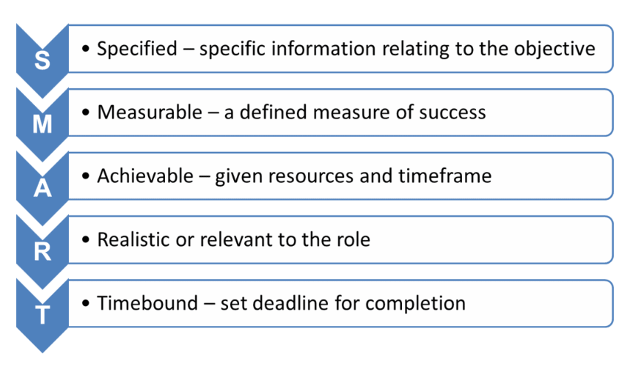
Activity 4: SMART Objectives
When might it be appropriate to set SMART objectives with a student?
Provide examples of SMART objectives
Notes:
ACTIVITY: Ask staff to consider when it might be appropriate to set SMART objectives with a student and to provide examples.
Teaching points
Allow 15 minutes for small groups to complete the activity. This is also referred to in the Revise and Refresh video on initial interview with an example provided.
On longer placements or for an outreach placement, students needing more structured planning might benefit from having SMART objectives set for shorter timescales, e.g. weekly.
SMART objectives are essential for an action plan (which is the responsibility of the Practice Assessor), so it is useful for the Practice Supervisor to have this understanding and use them in appropriate situations.

Slide 13
Supporting Learning in Practice
Coaching - guiding someone to explore all potential options and decide on a way forward
Advising - giving opinions or information which may or may not be taken, generally based on own experience
Instructing - giving someone an instruction, telling them how to do something
Counselling - helping someone to accept or take responsibility for something that has already happened
Mentoring - combines elements of all of the above
Notes:
Teaching points:
Ask the learners to give examples of these techniques in class discussion (5 minutes).
Learners were introduced to coaching in the introductory module and provided with the following definition and RCN video:
Coaching is an intervention that facilitates another person's learning, development and performance. Applied to student nurse practice placement learning, coaching has the potential to boost leadership learning that is student led, focused on students taking responsibility for identifying their learning goals and objectives.
(Leigh, Littlewood and Lyons 2019)
There are many examples of coaching models and strategies to enhance student learning all underpinned by ‘active’ as opposed to ‘passive’ learning.
The RCN video provides a positive example of using a coaching approach https://youtu.be/_RcUZy7e4_A
If they have not reviewed they video they should be encouraged to do so following the session, or you could include it here if you have time in the workshop (allow 5 minutes).

Slide 14
What is Assessment?
Assessment is making an evaluation of student’s level of competence and should support learning. It may involve different attributes including:
Skills
Knowledge
Attitude and Values
Behaviours
Helps to improve performance and motivate a student
Assessment is against certain criteria or standards identified in the student assessment document (PAD/online assessment tool/ongoing record of achievement)
Notes:
Teaching points
Part of the practice supervisor role is contributing to student assessment. Slides 14 to 25 look at what the PS needs to understand to assess students effectively.
Within the introductory e-learning module the learner was advised to review the relevant practice assessment document (available on the website).
They were also advised they could access the electronic practice assessment document (ePAD) for nurses and the ongoing record of achievement (eMORA) for midwifery and related guidance on this site.

Slide 15
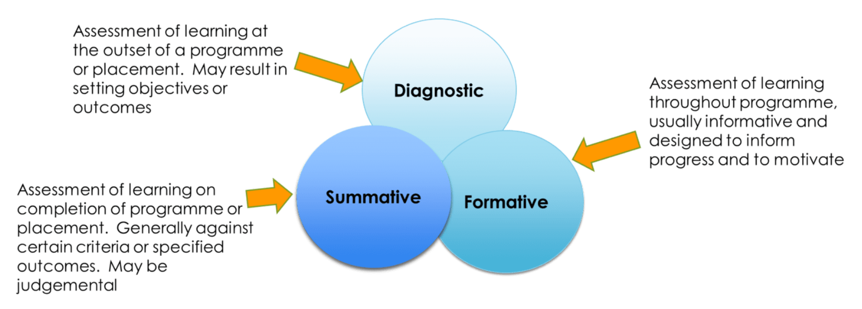
Types of Assessment
Notes:
Teaching points
Diagnostic assessment – we’ve already covered this (initial interview), so this is a reminder…
Carried out at the beginning of a placement, often based on student’s own self-awareness and self-assessment.
A SLOT analysis is a useful tool to encourage students to reflect and identify strengths, learning needs, opportunities and threats.
Will include assessment of knowledge, skills, attitude, experience, confidence.
It provides a baseline from which learning objectives can be established.
In the student assessment document, diagnostic is represented in the initial interview/learning plan
Formative assessment
Continuous assessment throughout placement involving regular feedback which may be based around learning objectives.
Helps to monitor progress, provide regular feedback to motivate and encourage.
Feeds into action plans.
Will be evidence based with information provided to inform feedback (we will look at effective feedback later in this workshop).
In the student assessment document, formative assessment is provided in the form of feedback, the mid-point interview (conducted by the PA) and in specific activities such as the first episode of care in Part 1 of pre-registration nursing programmes.
Summative assessment
Usually a formal process at specific points in the placement.
Assessment is against pre-set criteria and may take form of observation, OSCE, question and answer, assignments or exams.
Tends to be more judgemental and conclusive.
In the student assessment document, summative assessment is represented in all other formal assessment activities.

Slide 16
Activity 5: Areas and Methods of Assessment
From your experience of working with students on placement and completing the e-learning modules:
identify the key assessment components in the student assessment document
list the different methods used to support assessment
outline examples of supporting evidence that may be required to ensure all areas are effectively assessed
Notes:
Teaching points
As part of the e-learning module 'Fundamentals of the PS role' learners were directed to the assessment guidance documents on the website. If it is usual for students in the placement areas to use the ePAD the facilitator may wish to allocate more time to discuss the use of the ePAD and the PS role (there is a facilitator pack available via the PLPLG ePAD lead).
It’s the supervisor’s responsibility to prepare the student for assessments and therefore they must know which assessments will happen during the placement. These should be agreed with the practice assessor and documented within the initial interview/learning plan.
With agreement from the practice assessor, the practice supervisor may conduct the mid-point professional values assessment.
The practice supervisor may assess proficiency achievement. The practice assessor may spot check or confirm the assessment later with the student.
The practice supervisor usually completes the formative episode of care assessment, which is the first assessment in Part 1 for pre-registration programmes.
Only practice assessors may complete medicines management assessment. The student should be allowed a number of practice opportunities to administer medicines under supervision prior to this assessment.
The following slides look at the areas where the practice supervisor undertakes the assessment.

Slide 17
Components of Assessment
Initial, Mid-Point and Final interview processes are core to the learning and assessment of students.
Components in the nursing and nursing associate PADS include:
Professional Values
Proficiencies (including cross over proficiencies)
Episodes of Care
Medicines Management
Feedback from a range of people also contributes positively to the overall learning and assessment process including:
Practice supervisors; service users/carers; peers; other staff members
Notes:
Teaching points
This slide can be used to support feedback from learners and to summarise key aspects of assessment that the groups will hopefully have identified in the activity.
Check learners' understanding of cross over proficiencies. These are proficiencies that are not restricted to being achieved in one specific Part. Practice supervisors should be aware of any that may be gained in their placement setting so that the student does not miss that opportunity.

Slide 18
Methods of Assessment
Observation
Question and answer
Working alongside a student
Feedback from others
Discussion - particularly based on case study
Presentation
Reflective questioning
Notes:
Teaching points
To further support feedback from Activity 5.
Direct observation
Consider if student needs more guidance or further practice.
Would shadowing or role modelling help?
Consider how the student reacts in terms of behaviour and attitude.
Your presence may have an impact causing a student to be nervous, try to put them at ease, give them time out if needed
Check if the environment is affecting them, do they have reasonable adjustments that have not been met?
Questioning of related evidence-based practice
Asking questions to test a student on their base knowledge or theory underpinning activities
Working alongside the student
Assessing competence, confidence, attitude and behaviour whilst working with a student during an episode of care, visit to a patient’s home, working in an acute or community setting.
Feedback from others
This may come from a variety of sources including other healthcare professionals, service users and families, practice supervisors, colleagues
Should be formally gathered through the student assessment document.
May add credibility and balance as it provides different perspectives.
Case studies discussion
Discussion of different scenarios which may include patient stories, others’ experiences or case studies to assess the student’s understanding and how they would deal with a situation.
Presentation
Getting the student to give a formal or informal presentation on a topic, experience or interest.
Encourages student to research, prepare material and develop confidence in delivery.
Reflective questioning
Encourages learning through experience, developing self-awareness and ability to critically analyse and evaluate episodes of care.
Demonstrates knowledge and learning whilst informing future practice.

Slide 19
Supporting Evidence
All assessments should be based on supporting evidence, for example:
Notes taken during observations (or immediately after)
Student reflections during assessment (where applicable)
Feedback from others: colleagues, peers, service users (see next slide), other healthcare professionals
Notes:
Teaching points
Assessments will provide evidence or supporting information which may be used in an overall assessment of a student’s learning in practice.
Notes should be taken during observation (or immediately afterwards).
It is helpful to encourage students to reflect on their own assessment to consider areas of strength and areas of potential development.
Feedback from colleagues, healthcare professionals or service users is also helpful, however this should be written and be unbiased.
The more feedback from different sources the better as it provides a more balanced perspective and can be particularly helpful if there are concerns with performance, helping to inform decision making.

Slide 20
Professional Values
Students are required to demonstrate high standards of professional conduct at all times
Students should work within ethical and legal frameworks and be able to articulate the underpinning values of The Code (NMC, 2018)
Practice supervisors can assess professional values at placement mid-point, reporting back to the practice assessor
Practice assessors must make the final assessment at the end of the placement
Any lack of achievement by the student must be acted upon (see raising concerns slide)
Notes:
Teaching points
Key points to outline the importance of professional values and the PS role in assessment.
The facilitator may wish to use guides available on the website that includes examples of the forms.
The PS must pay specific attention to the requirements and provide opportunities to enable the student to facilitate achievement of these.
If any professional concerns are raised they need to be addressed promptly, documented and communicated to the PA and not left until the mid-point assessment. Involving the AA or representative is also important.

Slide 21
Proficiencies
Practice supervisors, who may be any registered health and social care professionals, can contribute to assessment (NB scope of practice)
Practice assessors have overall responsibility for the final assessment decision, based on evidence or through direct observation
Most proficiencies are specific to the Part of the programme that the student is in and must be assessed/achieved by the end of that Part in order for the student to progress, but
Some proficiencies may be assessed/achieved across multiple Parts, depending on the learning opportunities available to the student
Students are expected to maintain their level of performance and may be re-assessed where there are concerns (see Raising Concerns slide)
Notes:
Teaching points
Supervisors should be aware of ALL proficiencies applicable to the learning opportunities available in their practice area, and especially aware of those proficiencies that may be difficult for the student to access in other placements.
Supervisors must be mindful of the timing of the Part that the student is in (not all Parts follow the academic year) and ensure that students are able to achieve the required proficiencies without rushing towards the end of the Part or requiring retrieval placements.
The 4th bullet is referring to cross over proficiencies that we discussed earlier.

Slide 22
Formative Episode of Care
Part 1 nursing students will complete a formative episode of care assessment in their first or second placement
The practice supervisor can only assess the formative Episode of Care; all summative Episode of Care assessments must be carried out by the practice assessor
The practice supervisor should help prepare the student for summative assessments by facilitating opportunities to practice
To carry out an effective assessment the student must be given:
an opportunity to deliver a specific care activity under supervision
the opportunity to reflect on their individual performance
have specified time to discuss their reflection with their assessor
The assessor must then provide the student with specific written feedback
Please refer to additional assessment support materials
Notes:
Teaching points
Important for the Practice Supervisor to fully understand the purpose of EoC assessments and their role in providing opportunities as well as conducting the first formative assessment in Part 1.
Reference to Medicines Management assessment should be included here. Again, the importance of providing opportunities through practice needs to be emphasized – though the assessment must be undertaken by the PA.

Slide 23
Service User Feedback
Service users should not feel pressured to give feedback. They may decline to participate. They should not feel responsible for any ultimate decision affecting a student's progression
Patients who are too ill or vulnerable may not make an informed judgement
There may be concerns about anonymity. The person giving feedback must not be identifiable. The feedback is signed off by the supervisor in the PAD/online tool.
Service users may have preconceived ideas or expect different standards of care
Some may not understand what is expected of them in terms of 'feedback’ or feel it may be detrimental to their care if they provide negative feedback
There can be a bias in selection of service users
The standard template in the PAD/online tool must be used; it can be provided on paper if the service user is not comfortable using tech, or devices are not permitted in the practice setting
Notes:
Teaching points
Practice supervisors are responsible for identifying suitable opportunities for students to gain service user/carer feedback to inform assessment.
Service user feedback should be sought at least twice during a Part, usually during the longer placements. Follow specific guidance from the university if there is any.
This slide explains the considerations that supervisors must take into account to try to ensure feedback is a fair reflection of student performance.
There are a number of considerations when selecting service users including:
There may be an unconscious bias in selecting services users to provide feedback based on culture, religions, language and personality.
There may be a natural inclination to solicit feedback from patients who are appreciative, undemanding, have expressed positive views and who do not complain.
However, literature suggests that service user feedback is instrumental in highlighting performance issues in care particularly in areas like dignity, communication, compassion and privacy.
It is very important to remember that students should be assessed against pre-set standards and not against peers or service user expectations which may be subject to bias.
There may be specific challenges for students with neurodivergent conditions, who may need extra support.

Slide 24
Common Assessment Challenges
What factors could contribute to an assessment being invalid or unfair?
Inadequate feedback from practice supervisors, colleagues or others
Bias towards / against the student
Insufficient opportunity to observe and assess skills in the practice setting
Inappropriate method of assessment or lack of different methods employed
Student’s own readiness, preparation or nerves at the time
Student’s personal circumstances or neurodivergence not accommodated
Pre-conceived ideas based on other students’ performance or this student’s past performance
Lack of understanding of assessment documentation and completion requirements
Workload pressures leading to a rushed assessment
Notes:
Teaching points
It is the practice supervisor’s responsibility to prepare the student for assessment, working together with the student to meet their learning objectives
If the placement doesn’t support opportunities to practice some of the proficiencies, the supervisor should seek alternatives, e.g. case study work, outreach placements
The practice supervisor must ensure that the student’s personal circumstances or neurodivergence is accommodated in the way the assessment is performed (attendees should complete the e-learning module ‘Assessing neurodivergent students’)
Supervisors must ensure the student is being assessed for the right proficiencies at the right time in their programme
To reduce student (and staff) stress, assessments should be planned ahead and enough time must be allocated to complete them without rushing.
Implications of an invalid assessment:
Students may progress without achieving the standards and proficiencies required by the NMC
Students may be demotivated/staff time wasted by setting an action plan and needing re-assessment when they would have performed well if circumstances had been different, e.g. the assessment had not been rushed, reasonable adjustments/needs of neurodivergent students had been accommodated, the student had been given more practice opportunities.

Slide 25
Activity 6: Assessment Re-cap Activity
Working on your own:
State four methods of assessment
What are the four main areas of assessment that students must complete?
Give five reasons why assessments may be invalid
What could be the implications of an invalid or unfair assessment?
Notes:
Teaching points:
Quick assessment activity: Allow learners 5 minutes to complete on their own to test what they have absorbed.
State four methods of assessment. Any four of the following:
Observation
Question and answer
Working alongside a student
Feedback from others
Discussion -particularly based on case study
Presentation
Reflective questioning
What are the four main areas of assessment that students must complete?
Professional values
Proficiencies
Episode of care
Medicines management
(These are pre-registration nursing / NA related and may be different for other programmes)
Give five reasons why assessments may be invalid. Any five of the following:
Inadequate feedback
Bias towards / against the student
Insufficient opportunity to observe and assess skills
Inappropriate method of assessment or lack of different methods employed
Student’s own readiness, preparation or nerves at the time
Student’s personal circumstances or neurodivergence not accommodated
Pre-conceived ideas based on other students’ performance or this student’s past performance
Lack of understanding of assessment documentation and completion requirements
Workload pressures
What could be the implications of an invalid or unfair assessment?
A struggling student is not supported / a failing student is not identified
Student who is performing well is demotivated / unnecessary staff actions taken

Slide 26
Giving Effective Feedback
DO
Give timely feedback
Give specific examples
Be constructive and positive
Explore a way forward
Check student understanding
Record your feedback in the student assessment document
DON’T
Use the word 'but'
Use negative language
Criticise - be constructive
Generalise - be specific
Try to change personalities
Notes:
**Adapted from UoB Written Feedback Cheat Sheet (2022), Mark Waring, University of Bedfordshire**
Teaching points
The learner was directed to the Revise and Refresh video on Giving Effective Feedback as part of their preparation for the PS Workshop. If they have not viewed it they should be encouraged to do so.
• Focus on the ‘who, what, where, when and how’
Reflect on the performance of the learner using examples of what you have actually observed.
• Avoid being evaluative
If a learner is told there is practice is simply ‘good’ they may infer that no further development is necessary. The word ‘bad’ might be interpreted as final or incontestable. Phrases that explore the effectiveness, strength or weakness of aspects of a learner’s practice are more effective.
• Identify ‘to what end’ the feedback is to be given and whether the feedback needs to be shared
Determine which parts need to be written, which parts need to be verbal and identify the best location and place for the learner to feel safest and at the optimum time for the feedback to be ‘taken up’.
• Take into account whether the feedback should be given during performance or post-performance
Decide whether the feedback should be given as a ‘flow’ of information or be discursive where the student describes the episode of care and evaluates their own performance.
• Use suitable vocabulary that is inclusive (encouraging) rather than final (incontestable) and that allows responses and questioning from the learner. Be aware of non-verbal dynamics such as your body language.
• Include a balance of comments confirming good performance whilst emphasising improvement of performance in relation to standards of good work.
Provide examples by commenting on aspects of their work and behaviour.
• Provide the learner with strategies that are ‘forward-facing’ and ‘future referenced’ e.g. “When we work together next week we will…”; “in preparation for next week try…”
• End with a summary that enables the supervisor/assessor/educator to check shared understanding
Ask the learner to summarise the feedback given or identify the ‘take-home’ messages and next steps.

Slide 27
Activity 7: Effective Feedback Activity
Consider the following feedback examples and for each identify what is wrong and how you would improve it:
1. ‘Michael performed his A-E assessment well’
2. ‘Sarbjit’s communication skills need improvement’
3. ‘Throughout the episode Jo’s care delivery was inefficient’
4. ‘When undertaking the Berg balance score Nicky failed to maintain the patient’s safety’
5. ‘Chris needs to demonstrate a deeper knowledge of A&P’
6. ‘Leadership does not appear to be this student’s forte’
Notes:
**Adapted from UoB Written Feedback Cheat Sheet (2022), Mark Waring, University of Bedfordshire** This was covered in the Revise and Refresh video on Giving Effective Feedback, so learners should be familiar with the concepts.
Activity 7 - 15 minutes in small groups; one example per group.
Teaching points
Considerations
Example 1: ‘Michael performed his A-E assessment well’ - Michael does not know how well he has actually performed. He does not know what areas need further development and why. The giver of the feedback has not described or evaluated the nature of Michael’s performance including the accuracy, quality or effectiveness of the assessment, including the clinical implications. The conduct of the assessment and the outcome have not been differentiated.
Example 2: ‘Sarbjit’s communication skills need improvement’ - Sarbjit has not been told what type (verbal or non-verbal) or aspect of her communication skills that need improving and how. No attempt has been made to describe how she has communicated, with whom and to what effect.
Example 3: ‘Throughout the episode Jo’s care delivery was inefficient’ - The phrase ‘care delivery’ is opaque as no attempt has been made to describe what care was delivered, how it was delivered, why it was inefficient or an indication of what an acceptable standard of efficiency might be. The implications of Jo’s care has not been made clear and for whom.
Example 4: ‘When undertaking the Berg balance score Nicky failed to maintain the patient’s safety’ - There is no indication at what stage and how the patient’s safety was not maintained and to what effect or what the implications might have been for the patient. The giver of the feedback has not commented on other aspects of completing the balance score which may or not have been effective, efficient or accurate. Nicky would not know what level of competency she has based on this feedback.
Example 5: ‘Chris needs to demonstrate a deeper knowledge of A&P’ - Chris has not been told which aspects of anatomy and physiology need to be studied, why and to what effect. No reference has been made to a patient or clinical incident which means that Chris would not be able to contextualise the feedback or begin to understand the consequences or clinical implications of not having sufficient knowledge.
Example 6: ‘Leadership does not appear to be this student’s forte’ - The feedback not only lacks specificity but is incontestable. The giver of the feedback has conveyed an impression of absolute failure to the student. No practice examples have been given to support the assertion and there is no way forward agreed with the student.

Slide 28
Supporting Neurodivergent Students
Supporting Student Performance
We have a natural inclination to avoid negative situations, but managing under-performance should not be seen as negative.
An opportunity for the supervisor to understand the student’s learning challenges, e.g. their circumstances or neurodivergence, and provide better support
It helps the learner to understand specifically where they need to improve
The supervisor and student can agree strategies to improve their performance, e.g. SMART objectives. Remember to follow up.
Addressed early, gives a greater chance for the student to meet objectives within the placement and avoid the need for a formal action plan or a retrieval placement
Always record performance-related discussions within the student’s assessment document (PAD or online assessment tool)
Continuing concerns about performance, a serious performance issue or lack of achievement during assessment, must be escalated (see Raising Concerns slide)
Notes:
Teaching points
Every student deserves professional support to help them succeed on their programme.
This equally applies to their practice learning, and practice supervisors are responsible for ensuring students are supported according to their needs.
For some students this may require the practice supervisor to have regular meetings (catch-ups) with them and set SMART objectives where the student would benefit from more structure in their learning plan.
Where SMART objectives are set, the supervisor should agree the follow-up date and time so the student’s progress is monitored effectively.
The supervisor should encourage the student to discuss their specific challenges, including any personal circumstances or neurodivergent conditions that impact on their learning.
Any ongoing concern or serious performance issue must be escalated to the practice assessor.

Slide 29
Activity 8: Student Performance
Consider the following scenarios and for each identify the best approach to managing this as the practice supervisor:
1. A Part 2 learning disabilities student nurse is struggling with confidence issues
2. A Part 2 adult student nurse on a medical ward starts to re-sheath a needle after drawing up an antibiotic
3. A Part 2 child health student nurse on placement in the Children’s ED is struggling with drug calculations
4. A Part 3 Mental Health student nurse on placement in an Eating Disorder unit has complained about being given an action plan on time-keeping
5. A Part 1 student is coming towards end of placement and needs her assessment document completed
Notes:
Activity 8 - 15 minutes in small groups; one scenario per group
Teaching points
Some notes to support discussion with learners - not an exhaustive list
Scenario 1: Speak with student to identify any root cause for lack of confidence.
Consider :
• Level of student – may be first specialist experience.
• Past experiences- may not have had opportunities or received negative or unhelpful feedback
• Has the student got a learning plan / had initial interview and induction
• ? any personal issues
• ? specific learning needs
Once info gathered then speak to / update PA with any plans put in place to support and provide ongoing supervision/ support
Scenario2: Prevent student from re-sheathing
• Check understanding and previous experiences
• Explain risks and direct to policy / other learning resources
• Check student ‘new’ understanding
• Communicate with PA
Scenario 3: Speak to student to help you understand any underlying issues
Consider:
• Do they always struggle with numbers and ? any underlying learning need
• Have they covered much in terms of drug calculations in university
• Have they had experiences of administering medications on this placement / previous placement?
• Direct them to online resources and provide experiences with supervising medicine administration as seeing in action might make more sense
• Note actions taken in assessment document and ensure PA and other staff aware to ensure ongoing support
• Follow up at another time with student to review progress
Scenario 4
• Check student understanding of action plan
• Review action plan to ensure student expectations are clear
• Remind student re professional values – one of which is time-keeping and explain why
• Ask PA to have a further conversation with student so that they fully understand
Scenario 5
NB Students do very get very anxious if they are near to end of placement and documentation is not complete.
• Review student document/ ePAD to identify what is not yet complete
• Check that student has completed all of their requirements
• Are there any proficiencies that the PS can support with?
• Communicate with the PA re need to complete documentation or ward manager / education team if PA not available

Slide 30
Documentation
Practice supervisors and assessors are accountable for the assessment decisions made
Effective documentation:
must provide an appropriate level of information against criteria
include use of supporting information/evidence to inform decision, such as student reflections, feedback from colleagues or others, observation notes
be based on assessment against requirements (knowledge, skills, attitudes and values) set out in the student assessment document (PAD / online tool)
Notes:
Teaching points
Assessors are accountable for the decisions made and therefore these must be appropriately informed.
Assessors should be systematic in finding appropriate information, feedback and other evidence to justify any decisions made.
All decisions must be recorded in the student assessment document (PAD or online tool) against the appropriate competence.
Learners should familiarise themselves with the student assessment document (PAD/online tool). Paper versions and guides are included on the PLPLG website.
When assigned a student, the supervisor should obtain early access to their assessment documentation so that there is no delay in recording, which can reduce the detail/effectiveness and cause stress to students.
Within the London area, the Pan London ePAD is widely used. Self-learning resources, including guides and videos, are available on the PLPLG website and courses are available for new practice supervisors/assessors, provided either by the practice organisation or the partner university.

Slide 31
Supporting Neurodivergent Students
Raising Concerns
It is important for the PS to recognise underperformance, taking into consideration the level expected of the student at this stage and opportunities they’ve had
The PS must ensure the student is given the opportunity to improve with coaching and/or other practice experiences
Where concerns are of a serious or ongoing nature, or a lack of achievement during assessment, the PS must involve the PA, who will take overall responsibility and involve the AA in developing an action plan
Notes:
Teaching points
The important point for the PS is to raise matters with the PA as soon as they feel that the student is struggling.
The earlier it is raised, the sooner extra support and supervision can be agreed for the student to meet specific objectives and the more time the student has to improve their performance within the placement.
The development of an action plan and failure to improve performance is covered in the Practice Assessor module, as it is the practice assessor, with the academic assessor, who will manage this process.

Slide 32
References
Morley, D.A. Wilson, K. and Holbery, N. (2019) Facilitating Learning in Practice; A research-based approach to challenges and solutions, Oxon, Routledge.
Nursing and Midwifery Council (NMC) (2023) Standards of Education and Training @ Standards - The Nursing and Midwifery Council, London, Nursing and Midwifery Council
Royal College of Nursing (2019) Practice Supervision Using a Coaching Approach @ https://youtu.be/_RcUZy7e4_A London, Royal College of Nursing

Slide 33
Supporting Neurodivergent Students
What next?
Make full use of resources on the NMC, PLPLG and STEP websites
Familiarise yourself with the student assessment document (PAD / online assessment tool), which also contains further guidance. You will find examples and guides on the PLPLG website
Seek support from colleagues, education team or university link lecturer (depending on your organisation)
Attend update sessions when available and read update communications
Consider how undertaking this role will support your NMC revalidation (this workshop can comprise one of your reflective accounts for submission)
A certificate of achievement will be sent to you following the workshop (3 hours = 3 CPD points)
Notes:
Notes: Facilitator to summarise, check if there are any final queries/questions and confirm that a certificate to reflect the learner’s preparation as a practice supervisor will be emailed to attendees. A template for the certificate will be made available to facilitators.

